Slide 1
"Revolutionizing Ashok Leyland: A Comprehensive Digital Marketing Strategy"
TEAM ID : LTVIP2023TMID11824
PROJECT TITLE : COMPREHENSIVE DIGITAL MARKETING FOR ASHOK LEYLAND LTD
TEAM LEADER : KAMEPALLI CHANDINI
TEAM MEMBERS : SUNDRU NAGAVAMSI
MADAMANCHI VENKATESH
THOTA SURESH

Slide 2
CONTENTS
Brand study
Competitor Analysis & Buyer’s/Audience’s Persona
SEO & Keyword Research
Content Ideas And Marketing strategies
Content Creation And Curation

Slide 3
BRAND STUDY
Ashok Motors was founded by Mr.Raghunandan Saran in the year 1948 in Chennai Tamilnadu. Ashok Motors was setup in collaboration with Austin Motor Company. England and incorporated on September 7th for the assembly of Austin cars.
The first A40 Assembled
Production began in September at the factory situated at Ennore, South of Madras and soon the first indigenously assembled A40 Austin car was rolled out.
Assembly of Leyland chassis commence
The first Leyland chassis assembled by Ashok Motors at Ennore were four Comet 350 engine tippers sold to the Mangalore tile factory.

Slide 4
Government Approved for Manufacture of Commerical vehicles
The government approved the progressive manufacture of Leyland commercial vehicles and a license for the manufacture of 1,000 Comet a year was granted.
Ashok Motors becomes Ashok Leyland(1995)
Named after Raghunandan son, Ashok, the company was renamed Ashok Leyland with equity participation from Leyland Motors, Ltd
India’s first double decker arrives(1967)
‘Titan’-The first Indian made double decker with 50% indigenous components was launched.
Production target upped to 10,000 vehicles a year(1972)
The license to manufacture 10,000 vehicles a year was granted.

Slide 5
Two major new truck introduction(1980)
India’s first 13-ton truck-’Tusker’ with a 125 hp engine was launched followed by the country’s first multi-axle truck-’Taurus’.
First Indian auto company to receive ISO 9001 certification(1993)
This was followed two years later with the ISO 9001 certification.
Another innovation in alternate fuel technology (2002)
The country’s first hybrid electric vehicle was developed and show cased at Auto Expo 2002.
India’s First Hybrid CNG Plug-in Bus(2010)
Showcased at Auto Expo 2010 and later did service during the Common wealth Games moving VIPs and media at PragatiMaidan, New Delhi.
A full range player with DOST(2011)
Entry into the Light Commercial Vehicle(LCV) segment.

Slide 6
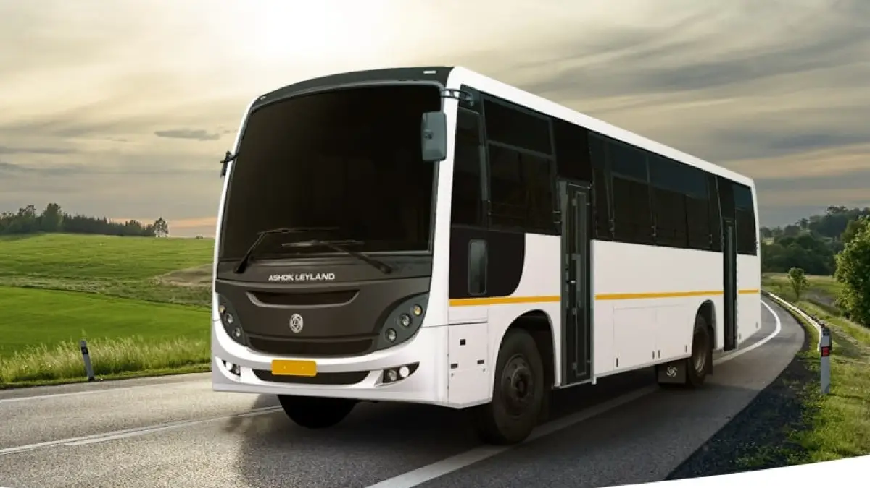
PRODUCTS OF LEYLAND
BUSES
Ashok buses move some 70 million people every day on their destination. From 18 seaters to 80 seaters, Ashok Leyland has an extensive range of buses that fits almost every requirements.

Slide 7
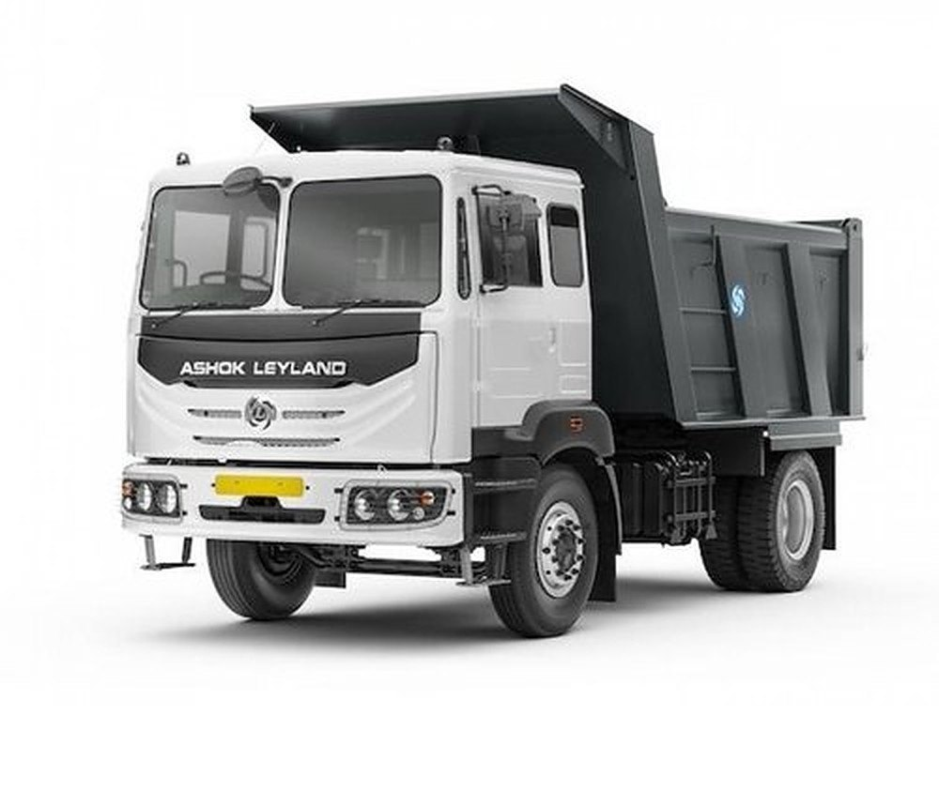
TRUCKS
Ashok trucks have been the wheels of the economy for decades. They offer a comprehensive range for a variety of applications: long haul, distribution, construction & mining.

Slide 8
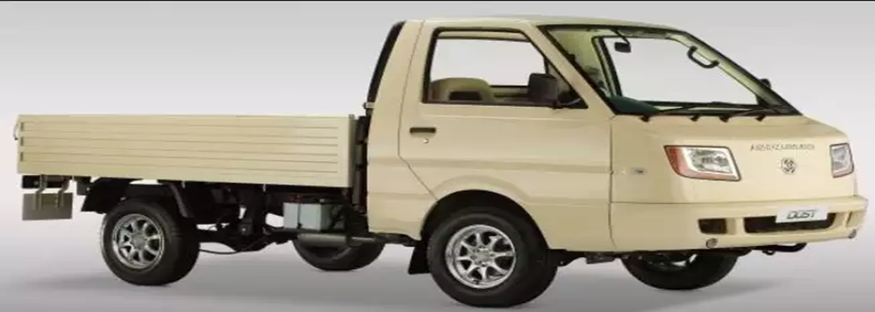
LIGHT VEHICLES
The light vehicle segment has come to the fore with fractional , last mile delivers of consumables becoming critical. Their DOST, a vehicle with a rated payload of 1.25 tones, is positioned to meet an evolving market need fir slightly heavier due to higher aggregation of small loads.

Slide 9
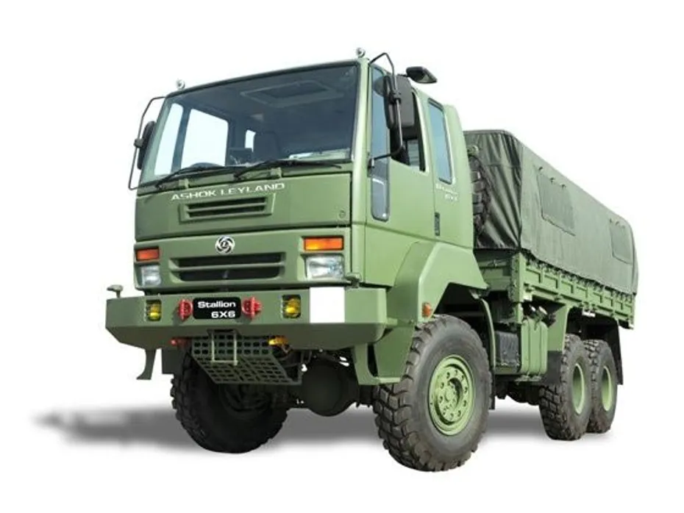
DEFENCE VEHICLES
They have developed two more platforms the COT and the SUPER STALLION. Going forward , they are expanding their stallion range of logistic transport solutions while tactical or armored vehicles will be offered on all three platforms on the back of strategic partnership with KMW, Germany, Pan hard, France, Paramount, South Africa.

Slide 10
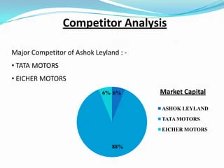
COMPETITOR ANALYSIS
Ashok Leyland’s major competitors are Eicher’s Volvo, Mahindra & Mahindra, Tata Motors, and Bharat Benz.
Business-wise, All of its competitors make sure that they keep Ashok Leyland’s price, quality, and other safety standards in check. But let us see what Ashok Leyland’s competitors are up to on their social media and digital marketing strategies.

Slide 11
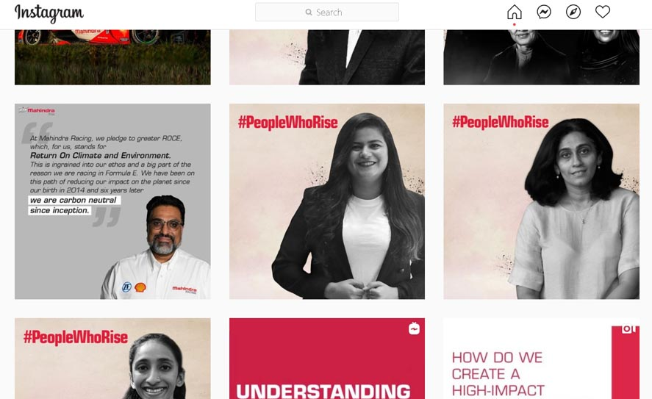
1. Mahindra & Mahindra
Mahindra & Mahindra has a page on Instagram, Facebook, and Twitter. They post frequently and their content is customer-centered. Using the hashtag #PeopleWhoRise, they share inspirational stories to connect well with their customers on their social media handles. It also commands a strong digital presence over all of its competitors.

Slide 12
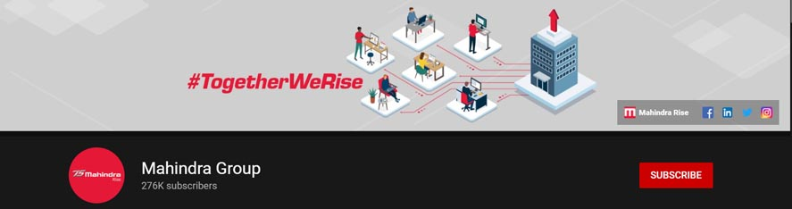
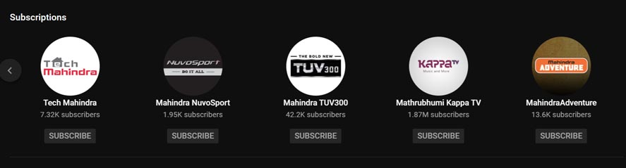
It also has a You tube channel for each of its automobile products and also has a main channel that showcases the Mahindra group as a whole.
It also has separate social media handles for its automobile products just like it has on You tube. Let us look at its other competitors.

Slide 13
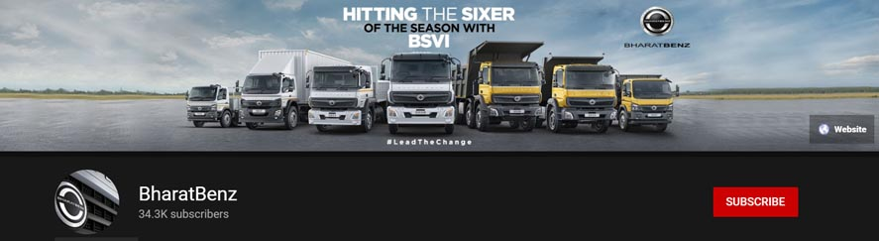
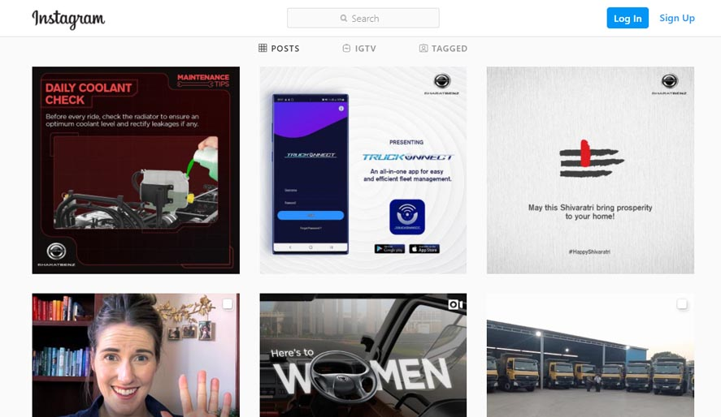
2. Bharat Benz
Bharat Benz is present on Facebook, Twitter, Instagram, and You tube as well. It has very few subscribers and followers compared to its competitors but it follows a similar strategy to that of Ashok Leyland’s. It posts information about its products and other financial videos along with occasional marketing campaigns and advertising films.

Slide 14
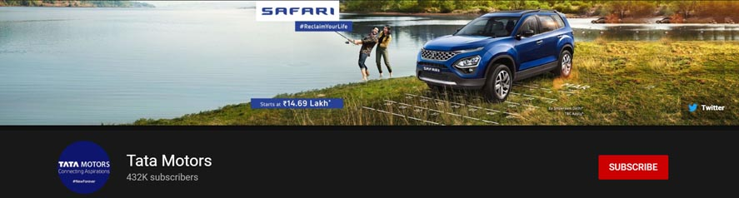
3. Tata Motors
Tata Motors has a YouTube channel and a Twitter account. It posts information on its products and achievements and frequently does so.
As a company, it is primarily a car manufacturing company and its YouTube and Twitter feed also focuses more on promoting cars and has less concentration on its heavy and commercial vehicle promotion.

Slide 15
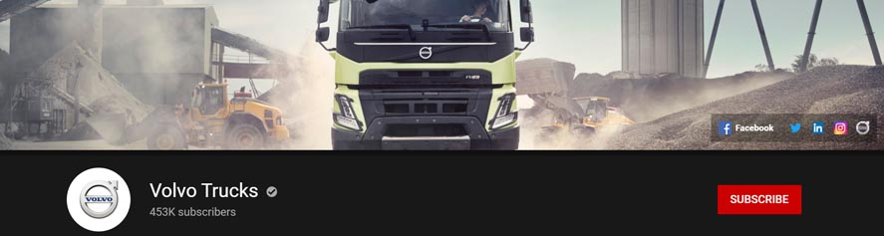
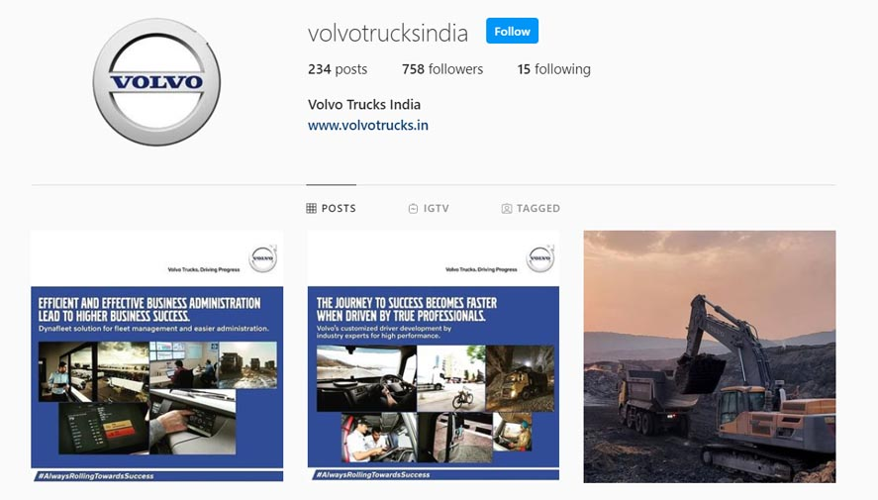
4. Eicher’s Volvo
Volvo Trucks has also a very strong presence on various digital platforms. It is almost present on all the major social media platforms. They post frequently and they post statistics and information related to their products and the company.

Slide 16
BUYER’S/AUDIENCE’S PERSONA
1. Fleet Manager Fiona
Demographic Information:
Age: 35-45
Occupation: Fleet Manager at a logistics company
Location: Urban and industrial areas
Income Level: Moderate to high
Psychographic Information:
Goals: Efficient and cost-effective fleet management, maximizing vehicle uptime, minimizing operational costs.
Challenges: Ensuring timely deliveries, reducing fuel consumption, maintaining a reliable fleet.
Interests: Advanced vehicle telematics, fuel-efficient technologies, long-term cost savings.
Buying Triggers:
Seasonal Demand: Needs to expand the fleet during peak seasons.
Operational Challenges: Current vehicles facing frequent breakdowns or high maintenance costs.

Slide 17
2. Entrepreneurial Esha
Demographic Information:
Age: 30-40
Occupation: Small business owner (e.g., local goods transportation)
Location: Semi-urban and rural areas
Income Level: Moderate
Psychographic Information:
Goals: Reliable transportation for goods, affordability, easy maintenance, fuel efficiency.
Challenges: Limited budget, finding affordable financing options, minimal knowledge about vehicle specifications.
Interests: Low initial investment, fuel-efficient engines, easy financing, after-sales support.
Buying Triggers:
Business Expansion: Starting a new venture or expanding an existing business requiring additional vehicles.
Reliability Concerns: Current vehicle becoming unreliable or costly to maintain.

Slide 18
3. Environmentally Conscious Elena
Demographic Information:
Age: 25-35
Occupation: Sustainability officer at a corporation
Location: Urban areas
Income Level: Moderate to high
Psychographic Information:
Goals: Environmentally friendly transportation solutions, reducing carbon footprint, promoting sustainable practices.
Challenges: Limited eco-friendly vehicle options, convincing stakeholders about the importance of green transportation.
Interests: Electric and hybrid vehicle options, emission reduction technologies, corporate social responsibility.
Buying Triggers:
Corporate Sustainability Initiatives: Company adopting green practices, looking for eco-friendly vehicle options to align with their environmental goals.
Regulatory Compliance: Anticipating future regulations related to emissions and environmental standards.

Slide 19

These buyer personas serve as fictional but informed representations of different types of customers Ashok Leyland might target. Tailoring marketing strategies and product offerings to cater to these diverse needs can help Ashok Leyland effectively reach its audience and address their specific concerns.

Slide 20
SEO & KEYWORD RESEARCH
Conducting SEO (Search Engine Optimization) and keyword research for Ashok Leyland involves understanding the company, its products, target audience, and industry-related terms that potential customers might use when searching online. Here’s a step-by-step guide for performing SEO and keyword research for Ashok Leyland.
1. Understand Ashok Leyland:
Products and Services: Familiarize yourself with Ashok Leyland's range of products, including trucks, buses, and other commercial vehicles, as well as any unique features or technology they offer.
Target Audience: Understand the specific industries and demographics Ashok Leyland caters to. This could include logistics companies, construction businesses, government agencies, etc.

Slide 21
2. Keyword Research:
Seed Keywords: Start with basic terms like "Ashok Leyland," "commercial vehicles," "trucks," and "buses."
Long-Tail Keywords: These are specific, longer phrases that users might search for, e.g., "fuel-efficient trucks for logistics," "Ashok Leyland electric buses," etc.
Competitor Analysis: Analyse keywords used by competitors like Tata Motors, Mahindra & Mahindra, and Eicher Motors.
Keyword Tools: Utilize keyword research tools like Google Keyword Planner, SEMrush, Ahrefs, or Ubersuggest to find relevant keywords and assess their search volumes.
3. On-Page SEO:
Title Tags: Optimize title tags of webpages with relevant keywords, e.g., "Ashok Leyland Trucks: Reliable Commercial Vehicles."
Meta Descriptions: Write compelling meta descriptions that include keywords and encourage users to click.
Header Tags: Use header tags (H1, H2, H3) in your content and incorporate keywords where appropriate.
URL Structure: Create SEO-friendly URLs containing relevant keywords, e.g., "ashokleyland.com/trucks/electric-trucks."

Slide 22
3. Local SEO:
Google My Business: Ensure Ashok Leyland’s Google My Business listing is accurate and optimized with relevant keywords.
Local Citations: List Ashok Leyland in online directories and business listings relevant to the automotive industry.
4. Technical SEO:
Mobile Optimization: Ensure the website is mobile-friendly for users on smartphones and tablets.
Page Speed: Improve website loading speed for a better user experience.
SSL Certificate: Secure the website with an SSL certificate for data encryption and user trust.

Slide 23
CONTENT IDEAS
Creating diverse and engaging content is crucial for Ashok Leyland to connect with its audience, showcase its expertise, and demonstrate the value of its products and services. Here are various content ideas tailored for Ashok Leyland's audience:
1. Product Showcase:
Feature Videos: Create high-quality videos showcasing different models of trucks, buses, and specialty vehicles. Highlight key features, innovations, and benefits.
Interactive Virtual Tours: Offer interactive 360-degree virtual tours of the interior and exterior of flagship vehicles.
2. Educational Content:
Infographics: Design infographics explaining concepts like eco-friendly technologies, safety features, or the evolution of commercial vehicles.
How-To Guides: Create guides on topics like vehicle maintenance tips, fuel efficiency, and choosing the right commercial vehicle for specific industries.

Slide 24
3. Case Studies and Testimonials:
Customer Success Stories: Share stories of businesses that have benefited from using Ashok Leyland vehicles, emphasizing challenges faced and how Ashok Leyland solutions helped.
Testimonials: Film or document testimonials from satisfied customers discussing their positive experiences with Ashok Leyland vehicles.
4. Industry Insights:
Whitepapers: Publish in-depth whitepapers on industry trends, future of transportation, or sustainability in commercial vehicles.
Expert Interviews: Conduct interviews with industry experts, engineers, or Ashok Leyland executives discussing the future of transportation and innovations in commercial vehicles.
5. Interactive Content:
Quizzes and Polls: Engage the audience with interactive quizzes related to commercial vehicles or polls about their preferences.
Interactive Configurators: Develop online tools allowing users to customize their ideal commercial vehicle, exploring various features and options.

Slide 25
6. Safety and Sustainability:
Safety Guides: Develop guides and videos on safe driving practices, road safety tips, and vehicle maintenance for commercial vehicle operators.
Green Initiatives: Showcase Ashok Leyland's sustainability efforts, such as eco-friendly vehicle options, emission reduction technologies, and green manufacturing practices.
7. Customer Engagement:
Online Forums: Create an online forum or community where Ashok Leyland users can share experiences, ask questions, and interact with the company.
Social Media Challenges: Launch social media challenges related to responsible driving, vehicle cleanliness, or creative use of commercial vehicles.
By diversifying content across these categories, Ashok Leyland can engage its audience effectively, establish its expertise in the industry, and create a loyal customer base. Remember to tailor the content to specific platforms and audience segments for maximum impact.

Slide 26
MARKETING STRATEGIES
Marketing is a crucial part of any industry to garner a positive image in the market. Ashok Leyland has been active in implementing its marketing strategy among different regions and countries. It has undertaken various marketing campaigns over the years and some major ones are highlighted in this section.
Driver’s Anthem – A Marketing Campaign of Ashok Leyland
Ashok Leyland Driver’s Anthem is one of its really popular campaigns that resonated well with the community.
This anthem focuses on answering questions such as, “Who are our truck drivers?“ “Where do they come from?” and “What keeps them going?”. It salutes fellow drivers and their hard work for being the driving force of the nation.
The tone of the composition is inspiring and heart-warming. It is one of the finest campaigns of Ashok Leyland.

Slide 27
https://youtu.be/f9Ea77SDqAI
It was targeted at the general audience, who liked it a lot, while it also got a lot of appreciation from the transport fraternity.
Touching Lives – A Marketing Campaign of Ashok Leyland
Ashok Leyland Touching Lives, this campaign was released when Ashok Leyland as a company, completed 70 years in the business.
This campaign focused on showcasing how Ashok Leyland has come a long way since its inception in 1948 and how it has been a part of millions of lives, their stories, and their journeys over the last 70 years.
It pointed out to its customers that, “We are here, where we are today, because of the trust that you have put in us”.
https://youtu.be/S8LtFQWMID0
This was another popular ad campaign that was received well by the audience. Let us now understand how Ashok Leyland has worked out in implementing its social media marketing strategies.

Slide 28
CONTENT CREATION AND CURATION
1. Blog Posts:
Industry Insights: Write about trends, challenges, and innovations in the commercial vehicle industry.
Customer Stories: Share success stories of businesses that have improved operations with Ashok Leyland vehicles.
Maintenance Guides: Provide tips and guides on vehicle maintenance, extending the lifespan of Ashok Leyland vehicles.
Sustainability: Discuss Ashok Leyland's green initiatives, such as electric vehicles and eco-friendly manufacturing practices.
Event Highlights: Cover events, conferences, and expos related to the automotive industry.
2. Videos:
Product Demos: Create detailed video demonstrations of Ashok Leyland vehicles, highlighting features and benefits.
Customer Testimonials: Film satisfied customers talking about their positive experiences with Ashok Leyland vehicles.

Slide 29
Factory Tours: Offer virtual tours of manufacturing facilities, showcasing the production process and quality standards.
Educational Animations: Develop animations explaining complex vehicle technologies in a simple and engaging manner.
3. Infographics:
Comparative Infographics: Compare Ashok Leyland vehicles with competitors, highlighting advantages.
Emission Reduction: Visualize the environmental impact of Ashok Leyland's eco-friendly vehicles.
Safety Features: Showcase the safety features of Ashok Leyland vehicles in an easy-to-understand format.
4. Podcasts:
Industry Interviews: Conduct interviews with industry experts, discussing the future of commercial vehicles and transportation.
Company Insights: Share behind-the-scenes stories about Ashok Leyland, its employees, and the company culture.
Customer Spotlights: Feature conversations with satisfied customers, detailing their experiences with Ashok Leyland vehicles.

Slide 30
5. Interactive Content:
Online Configurators: Develop tools allowing users to customize and visualize their ideal Ashok Leyland vehicle.
Quizzes: Create interactive quizzes related to commercial vehicles, safety, and industry knowledge.
Polls: Conduct polls on social media platforms, engaging the audience with questions about vehicle preferences and industry trends.
6. Social Media Content:
Visual Storytelling: Use visually appealing graphics, images, and short videos to tell stories about Ashok Leyland’s products and achievements.
Live Q&A Sessions: Host live question-and-answer sessions on social media platforms, allowing the audience to interact directly with Ashok Leyland representatives.
Behind-the-Scenes: Share glimpses of the manufacturing process, employee activities, and corporate events.
7. Guides and Ebooks:
Buyer’s Guides: Create comprehensive guides to help businesses choose the right Ashok Leyland vehicles for their specific needs.

Slide 31
Ebooks: Publish ebooks on topics like the future of transportation, sustainability in the automotive industry, and the evolution of commercial vehicles.
8. Interactive Webinars:
Educational Webinars: Host webinars discussing topics such as vehicle maintenance best practices, fleet management strategies, and the benefits of Ashok Leyland’s technologies.
Product Launch Events: Conduct virtual launch events for new vehicle models, showcasing their features and advantages to a global audience.
9. User-Generated Content Campaigns:
Photo Contests: Organize contests encouraging users to share creative photos featuring Ashok Leyland vehicles.
Success Story Submissions: Invite customers to submit their success stories, rewarding the best submissions with recognition and prizes.

Slide 32
THANK YOU

